Slide 1
System Architecture Evolution (SAE) in 5G:
SAE is core network architecture of 3GPP’s LTE wireless communication standard.
System Architecture Evolution (SAE) is a key aspect of the 5th generation of mobile networks, commonly known as 5G.
It represents a significant evolution from the architecture used in previous generations (3G and 4G).

Slide 2
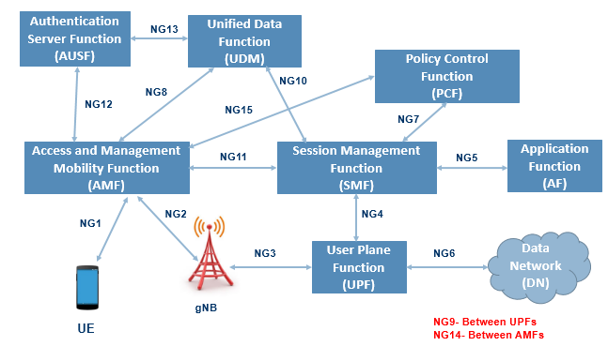

Slide 3
Here are some key points about SAE in the context of 5G:
Core Network Transformation
Service-Based Architecture (SBA)
Network Function Virtualization (NFV)
Software-Defined Networking (SDN)
Ultra-Reliable Low Latency Communications (URLLC)
Enhanced Mobile Broadband (eMBB)
Network Slicing

Slide 4
It’s important to note that the evolution of system architecture is an ongoing process, and developments may have occurred since my last update. It introduces a service-based architecture.

Slide 5
THANK YOU

